Slide 1
Mann-Whitney U Test
The Mann-Whitney U test is a non-parametric test used to compare two independent samples to determine whether they come from the same distribution. Unlike the t-test, it does not assume normality and is useful for ordinal data or when the sample sizes are small and the distribution is unknown. The test ranks all the observations from both groups together, then compares the sum of ranks between the two groups.

Slide 2
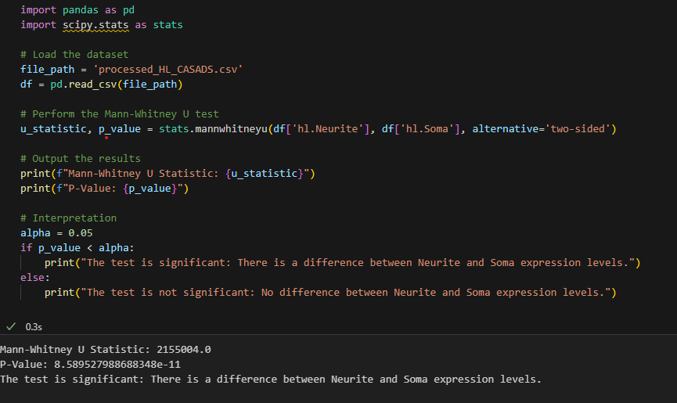

Slide 3
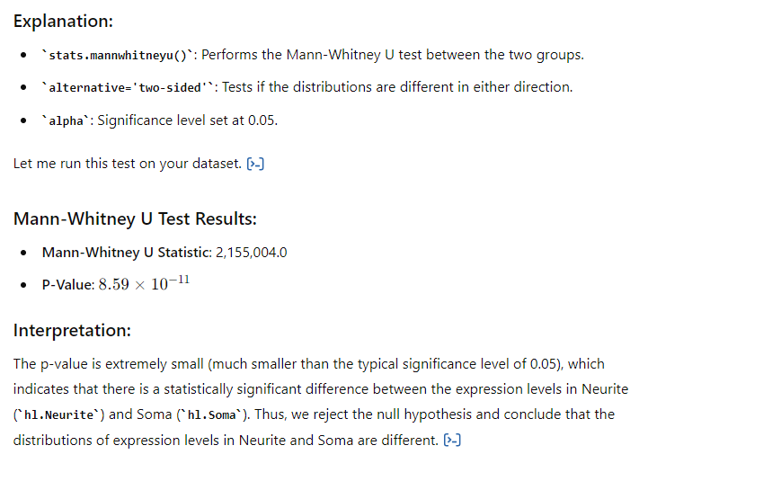

Slide 4
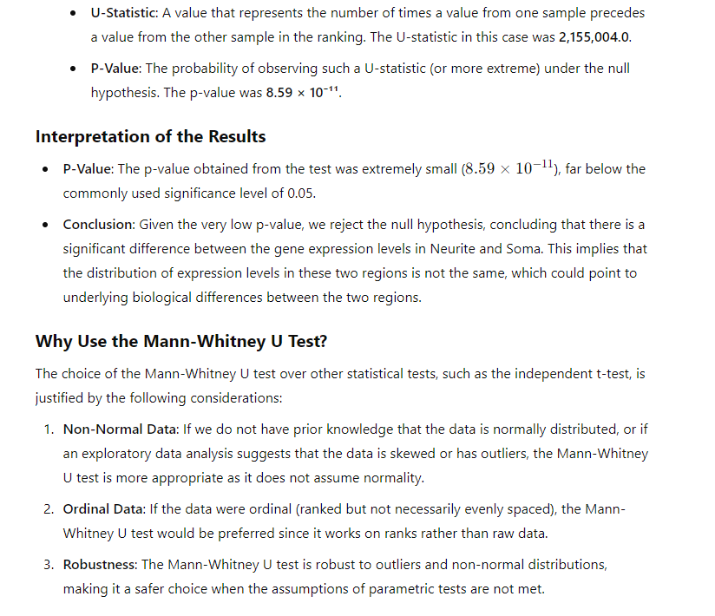

Slide 5
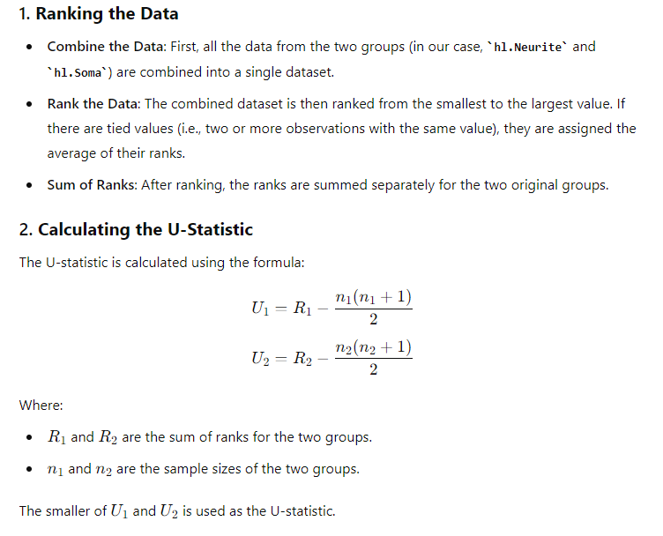

Slide 6
